Slide 1
Stoichiometry
Chapter 12

Slide 2
Chemical Equations
Balanced chemical equations provide a great deal of information
Formulas describe what substances are involved in the chemical change
Coefficients provide the relative numbers of these chemical species
Allows a quantitative assessment between the amounts of substances consumed and produced by the reaction – known as the reactions stoichiometry

Slide 3
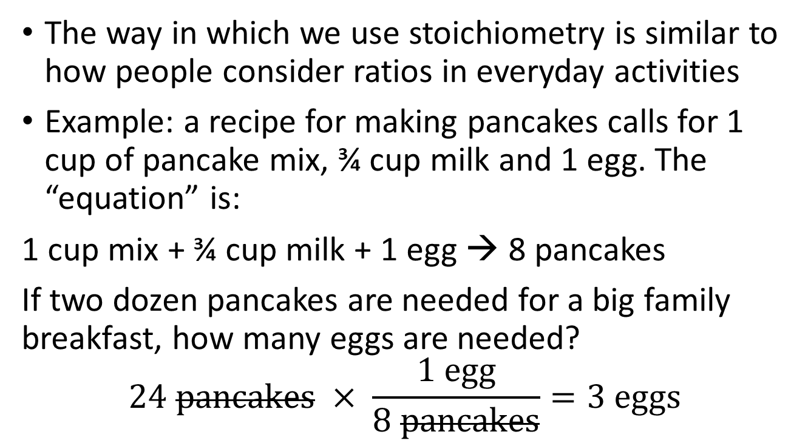
Stoichiometry
The way in which we use stoichiometry is similar to how people consider ratios in everyday activities
Example: a recipe for making pancakes calls for 1 cup of pancake mix, ¾ cup milk and 1 egg. The “equation” is:
1 cup mix + ¾ cup milk + 1 egg → 8 pancakes
If two dozen pancakes are needed for a big family breakfast, how many eggs are needed?
$$24 pancakes × \frac{1 egg}{8 pancakes}=3 eggs$$

Slide 4
Stoichiometry
Balanced equations are used in the same way to determine the amount of one reactant required to react with a given amount of another reactant, or to yield a give amount of product, etc.
The coefficients in a balanced equation are used to derive stoichiometric factors (conversion factors)

Slide 5
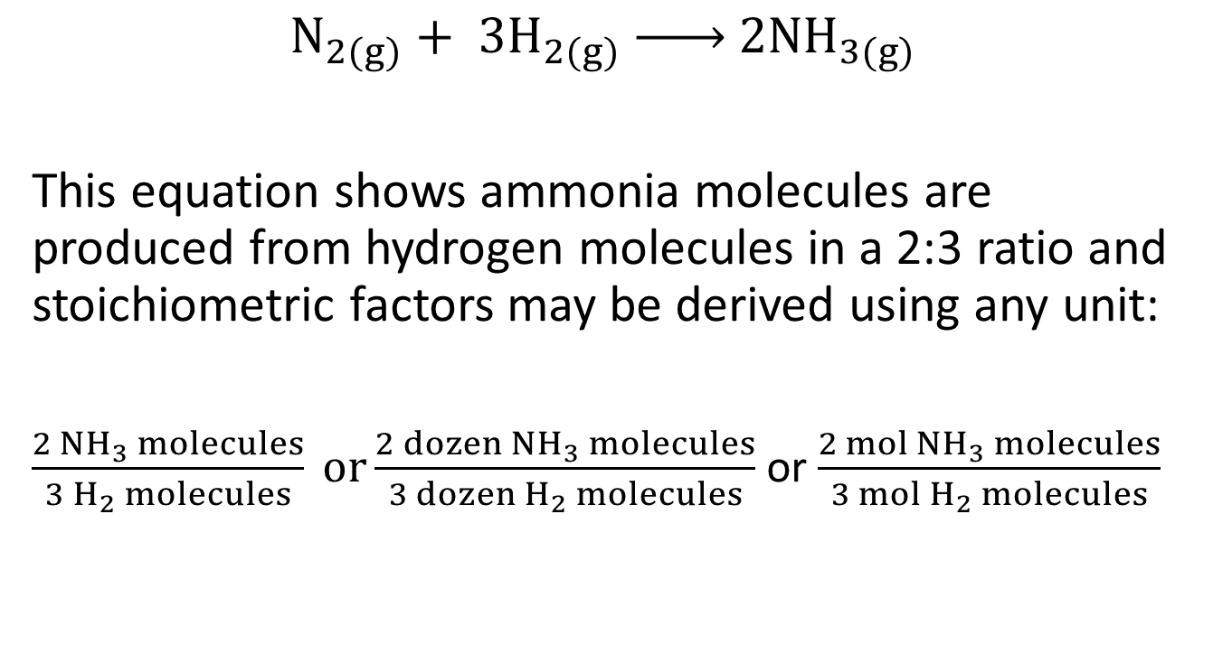
Example
$$N_{2(g)}+ {3H}_{2(g)} \underset{→}{ } {2NH}_{3(g)}$$
This equation shows ammonia molecules are produced from hydrogen molecules in a 2:3 ratio and stoichiometric factors may be derived using any unit:
$\frac{{2 NH}_{3} molecules}{{3 H}_{2} molecules} or\frac{{2 dozen NH}_{3} molecules}{{3 dozen H}_{2} molecules}$ or $\frac{{2 mol NH}_{3} molecules}{{3 mol H}_{2} molecules}$

Slide 6

How many moles of I₂ are required to react with 0.429 mol of Al according to the following equation
2${Al}_{(s)}+ {3I}_{2(s)} \underset{→}{ } {2AlI}_{3(s)}$

Slide 7
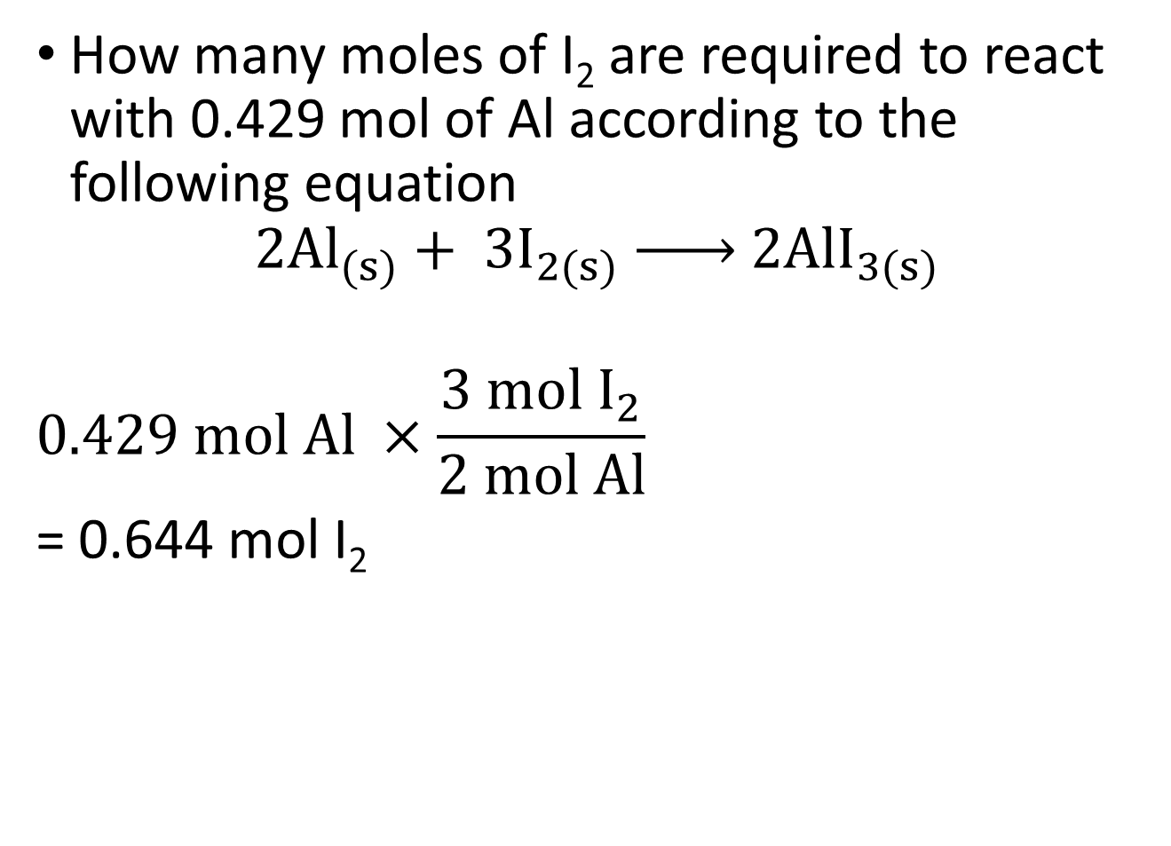
How many moles of I₂ are required to react with 0.429 mol of Al according to the following equation
$${2Al}_{(s)}+ {3I}_{2(s)} \underset{→}{ } {2AlI}_{3(s)}$$
$$0.429 mol Al ×\frac{3 mol I_{2}}{2 mol Al}$$
= 0.644 mol I₂

Slide 8

How many moles of Ca(OH)₂ are required to react with 1.36 mol of H₃PO₄ to produce Ca₃(PO₄)₂ according to the equation:
${3Ca(OH)}_{2}+{2H}_{3}{PO}_{4} \underset{→}{ } {Ca}_{3}{(PO}_{4})_{2}+{6H}_{2}O$

Slide 9
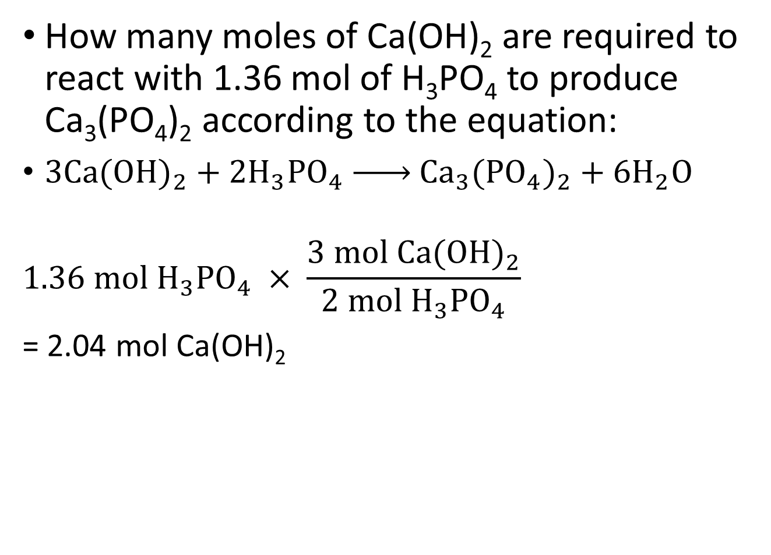
How many moles of Ca(OH)₂ are required to react with 1.36 mol of H₃PO₄ to produce Ca₃(PO₄)₂ according to the equation:
${3Ca(OH)}_{2}+{2H}_{3}{PO}_{4} \underset{→}{ } {Ca}_{3}{(PO}_{4})_{2}+{6H}_{2}O$
$$1.36 mol H_{3}{PO}_{4} × \frac{3 mol {Ca(OH)}_{2}}{2 mol H_{3}{PO}_{4}}$$
= 2.04 mol Ca(OH)₂

Slide 10
Molar quantities review
Recall that molar mass can be used to convert from mass to moles
Practice:
How many moles are 12.10 g of Fe?
What mass is 1.225 mol of water?
How many moles are 125 g of aluminum oxide?

Slide 11
Molar quantities review
Recall that molar mass can be used to convert from mass to moles
Practice:
How many moles are 12.10 g of Fe?
0.2167 mol
b) What mass is 1.225 mol of water? 22.07 g
c) How many moles are 125 g of aluminum oxide? 1.23 mol

Slide 12
Gravimetric stoichiometry
Previously we used the coefficients of a balanced chemical equation to convert from an amount in moles of one substance to an amount in moles of another.
We can also use molar mass to convert between values in grams and moles to allow conversions from the mass of one reactant or product to the mass of another reactant or product

Slide 13
Mass to Mass Problem
6.50 grams of aluminum reacts with an excess of oxygen. How many grams of aluminum oxide are formed?
We will answer this problem in three steps:
Mass of aluminum
Mass of aluminum oxide
molar mass
molar mass
molar ratio
(from chemical equation)
Moles of aluminum
Moles of aluminum oxide

Slide 14
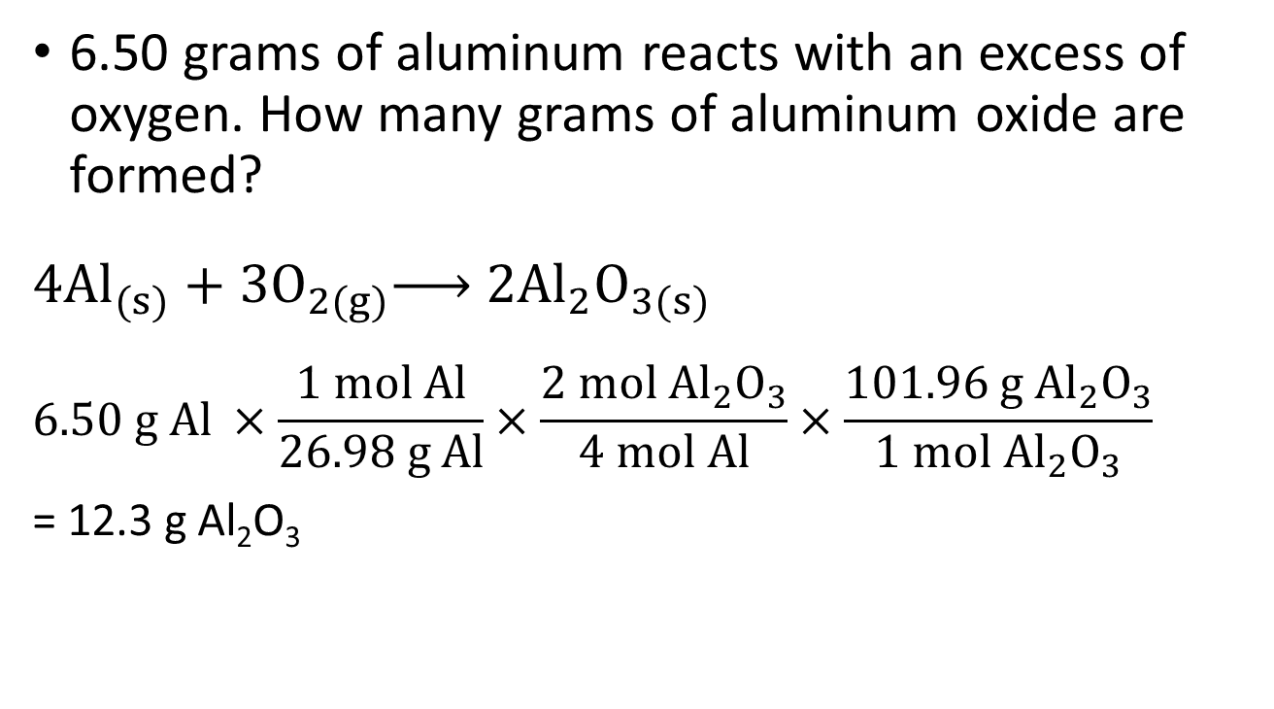
Mass to Mass Problem
6.50 grams of aluminum reacts with an excess of oxygen. How many grams of aluminum oxide are formed?
$$4{Al}_{(s)}+{3O}_{2(g)}\underset{→}{ } 2{Al}_{2}O_{3(s)}$$
$$6.50 g Al ×\frac{1 mol Al}{26.98 g Al}×\frac{2 mol {Al}_{2}O_{3}}{4 mol Al}×\frac{101.96 g {Al}_{2}O_{3}}{1 mol {Al}_{2}O_{3}}$$
= 12.3 g Al₂O₃

Slide 15
Example
Solid iron reacts with a solution of copper (II) sulfate to produce an iron (III) sulfate solution and solid copper. If 10.1 g of Fe are added to a solution of copper (II) sulfate, how many grams of solid copper would form?

Slide 16
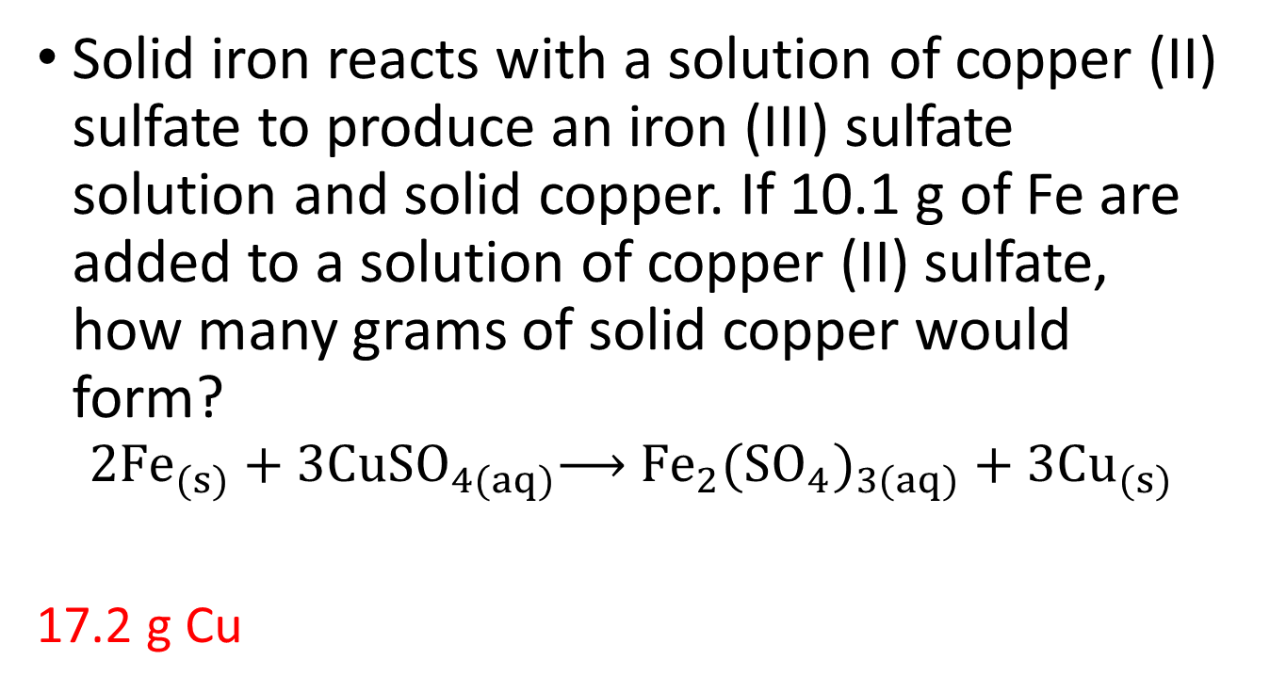
Example
Solid iron reacts with a solution of copper (II) sulfate to produce an iron (III) sulfate solution and solid copper. If 10.1 g of Fe are added to a solution of copper (II) sulfate, how many grams of solid copper would form?
$${2Fe}_{(s)}+{3CuSO}_{4(aq)}\underset{→}{ } {Fe}_{2}{(SO}_{4})_{3(aq)}+{3Cu}_{(s)}$$
17.2 g Cu

Slide 17
Example
Aqueous lithium hydroxide reacts with hydrobromic acid to yield lithium bromide and water. If you start with 10.0 g of lithium hydroxide, how many grams of lithium bromide will be produced?

Slide 18
Example
Aqueous lithium hydroxide reacts with hydrobromic acid to yield lithium bromide and water. If you start with 10.0 g of lithium hydroxide, how many grams of lithium bromide will be produced?
36.3 g LiBr

Slide 19
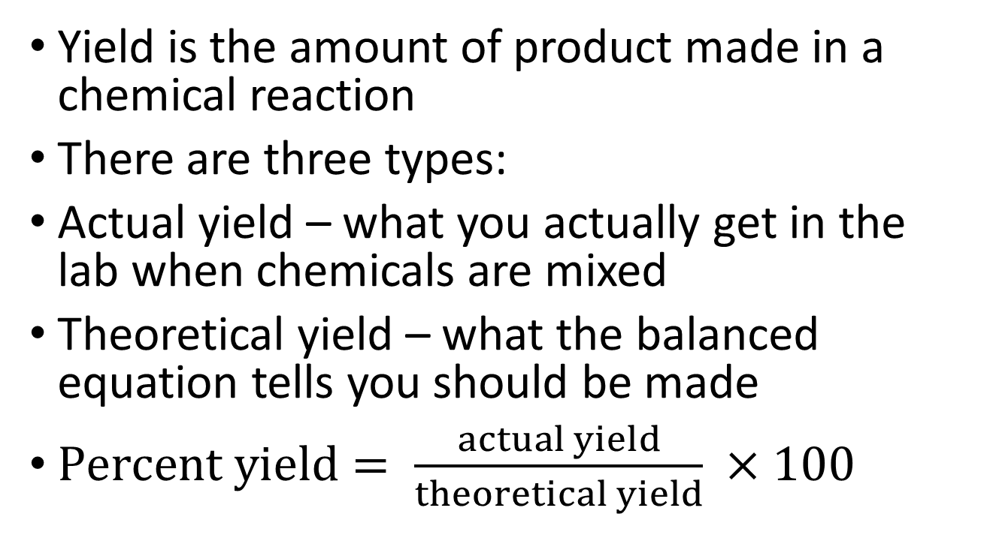
Yield
Yield is the amount of product made in a chemical reaction
There are three types:
Actual yield – what you actually get in the lab when chemicals are mixed
Theoretical yield – what the balanced equation tells you should be made
$Percent yield= \frac{actual yield}{theoretical yield} ×100$

Slide 20
Example
6.78 g of copper is produced when 3.92 g of aluminum are reacted with an excess of copper (II) sulfate.
2Al + 3 CuSO₄ → Al₂(SO₄)₃ + 3Cu
What is the actual yield?
What is the theoretical yield?
What is the percent yield?

Slide 21
Interpreting yield
Percent yield tells us how “efficient” a reaction is
Percent yield cannot be bigger than 100%
inaccurate results and error may lead to results larger than 100%
Theoretical yield will always be larger than actual yield
Why? Due to impure reactants; competing side reactions; loss of product in filtering or transferring between contains; measuring

Slide 22
Limiting Reagent
If you are given one dozen loaves of bread, a gallon of mustard, and three pieces of salami, how many salami sandwiches can you make?
The limiting reagent is the reactant you run out of first
The excess reagent is the one you have left over
The limiting reagent determines how much product you can make

Slide 23
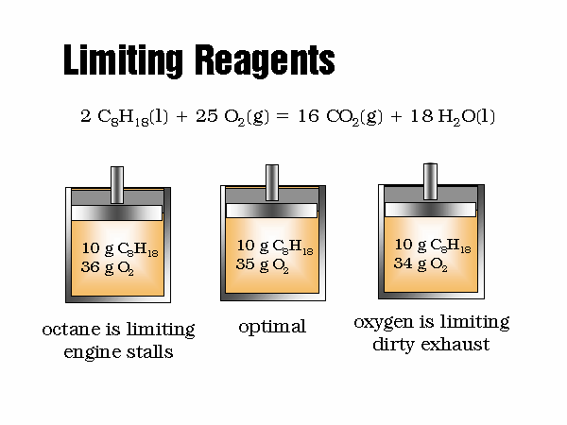
Limiting Reagents - Combustion
$${2 C}_{8}H_{18(l)}+{25 O}_{2(g)}\underset{→}{ }{ 16 CO}_{2(g)}+{18 H}_{2}O_{(g)}$$

Slide 24
How do you determine which is the limiting reagent?
The chemical that makes the least amount of product is the limiting reagent
You can recognize limiting reagent problems because they will give you 2 amounts of chemical
Do two stoichiometry problems, one for each reagent you are given

Slide 25
Example
If 10.6 g of copper reacts with 3.83 g of sulfur. How many grams of product (copper (I) sulfide) will be formed?

Slide 26
Example
If 10.3 g of aluminum are reacted with 51.7 g of CuSO₄ how much copper (in grams) will be produced?
How much excess reagent will remain?

